Slide 1
Bias in NBA Scorekeeping:
Analyzing a Historic Season
Richard Francais

Slide 2
Overview of Scorekeeping in the NBA
All scorekeeping in the NBA is done by the home team. Three scorekeepers keep track of every statistic in the game.
Certain statistics such as blocks and assists, have subjectivity involved with determining credit.
An assist is defined as a pass that directly leads to a basket.
Due to the amount of free reign that the scorekeepers have, there may be an incentive or pressure to be create bias in the box score.

Slide 3

An example of this subjectivity
This video demonstrates the control a scorekeeper has on perception.

Slide 4
Russell Westbrook’s 2016-17 MVP Season
Westbrook became the 2nd player in NBA history to average a triple-double, the first being Oscar Robertson in 1961-62.
Since the “triple-double” is a completely arbitrary set of numbers, NBA scorekeepers may have felt pressured to nudge his numbers in the right direction due to the attention it got.

Slide 5
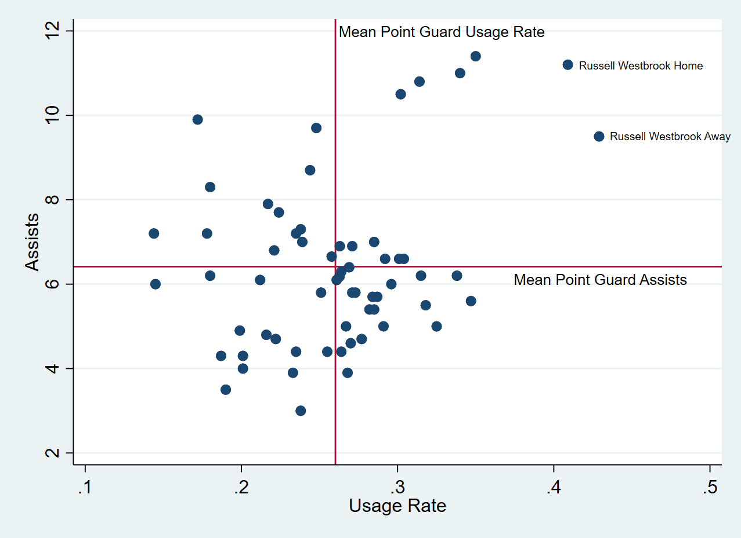
Visualizing Westbrook’s season
 | Assists | Usage Rate
Home | 11.2 | 40.9%
Away | 9.5 | 42.9%

Slide 6
Theoretical Model
Prob(TripleDouble)_{i} = β₀ + β₁Away_{i} (+/-) β₂USG_{i} (+/-) β₃TeamPPG_{i} (+/-) β₄PTS_{i} (+/-) β₅AST_{i} (+/-) β₆TRB
TripleDouble = 1 if triple-double, 0 if not.
Away = 1 if game is away, 0 if home
USG = Usage Rate
TeamPPG = Team’s points per game
PTS = Points scored by Westbrook
AST = Assists made by Westbrook
TRB = Total Rebounds made by Westbrook

Slide 7
tripledouble | Coef. | Std. Err. | z | P>z | [95% Conf. | Interval]
Away | -.8645257 | .84568 | -1.02 | 0.307 | -2.522028 | .7929766
USG | .071515 | .0865939 | 0.83 | 0.409 | -.0982059 | .2412358
TeamPPGPTS | .0289318 | .0475366 | 0.61 | 0.543 | -.0642383 | .1221019
PTS | .0258308 | .0660493 | -0.05 | 0.963 | -.1325554 | .1263533
AST | .8508304 | .2444337 | 3.48 | 0.000 | .3717492 | 1.329912
TRB | .5180443 | .1606798 | 3.22 | 0.001 | .2031178 | .8329709
_cons | -20.18508 | 7.513994 | -2.69 | 0.007 | -34.91224 | -5.457921

Slide 8
Conclusion
Although my model didn’t change history like I hoped, it did give us valuable insight into the factors that helped create Russell Westbrook’s historic season.
There seems to be a lot of static in comparisons between home and road stat lines.
Although there was no definitive evidence of home scorekeeping misrepresenting Westbrook’s stats, it still serves as a cautionary tale.

